Slide 1
EUMETNET E-AI WG Data Curation
Kick-off, 14 Oct 2024

Slide 2
AGENDA
13:00 - 13:15 Greetings and background
13:15 - 13:30 Round-table / Get to know each other poll
13:30 - 14:30 Proposed ToR / tasks for the WG
What do we want to do as a group? “I would need this"/ "I would like to participate with this N hours per month“
First deliverables
14:30 - 14:50 Working practices, tools, meetings
14:50 - 15:00 Next steps
Live minutes at: WG1-minutes_14102024 - Google Docs
Everyone are welcome to contribute to the minutes!
Minutes will be without names and gender neutral
Minutes will be left for edit for the rest of the week and then curated to GitHub

Slide 3
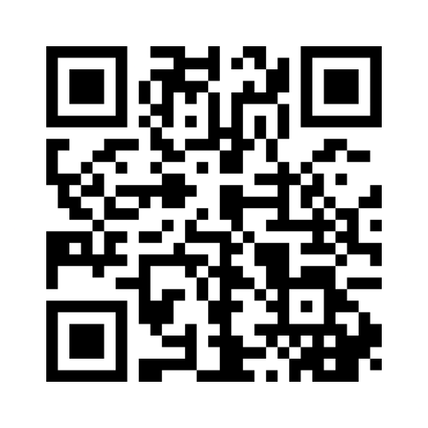
Round-table questionnaire
Where are you coming from?
What are you doing in the field of AI/ML?
What’s your relationship with the data (producer / user)?
What are you looking from this working group? How much time you estimate to have to contribute?
Poll: https://www.menti.com/altmce3sswaa
Please put organisation, github credential and email to the chat or put them to Email and Github handle collection | DFN-Terminplaner

Slide 4
Proposed Terms of Reference (ToR)
WG1s primary intention is to lower barriers in E-AI activities data usage by analysing available and missing data holdings, obstacles in using them, and creating examples of using and converting the data into a suitable form for Machine Learning. The considered applications cover weather forecasting (from nowcasting to seasonal), climate applications, and downstream products and services

Slide 5
Participation
Active Group Members: Individuals with a keen interest in contributing to deliverables
Passive Group Members: Individuals with an interest in the topic of data curation to gain general insights. No hands-on implementation is necessary

Slide 6
Proposed Terms of Reference (ToR) – First deliverable
Later to be extended to cover aspects such as
Data access, including data-proximate processing capabilities
License/access policies
Available format(s)
Access and usage examples
Tools to re-format and available converters
Need to prepare other formats (for 'hot' datasets)
Need to develop converters
Suitability (for which purpose it can be used)
Processing chain, how the data has been produced (e.g. quality control)
Gap analysis of used and missing data in AI/ML applications relevant to E-AI content
Recognising the datasets and considering why they are used or not used
If you are interested to contribute, please write to the chat or via email to roope.tervo@eumetsat.int; stephan.siemen@ecmwf.int; arianna.valmassoi@dwd.de

Slide 7
Proposed Terms of Reference (ToR) – Other activities
More comprehensive tutorials on data access, loading, and transformations
Zarr data structure standardisation and/or profiles for different use cases
Create a mechanism for sharing data inside the community; registry of relevant data sets focused on E-AI activities with aspects mentioned in analyses above
Your topic?
We, as a Working Group, will decide on other activities and deliverables
If you are interested to contribute, please write to the chat or via email to roope.tervo@eumetsat.int; stephan.siemen@ecmwf.int; arianna.valmassoi@dwd.de

Slide 8
Practicalities
Live minutes at Google Docs → to be moved to GitHub after the meeting
All resources (including presentations, deliverables, minutes, examples, code…) in GitHub: https://github.com/eumetnet-e-ai/wg1_data_curation
Email lists to be set up
Does the group have interest for a chat channel on https://chat.europeanweather.cloud ?
Meeting frequency proposal
Working meetings every 2 weeks
Interest group meetings every 3 months

Slide 9
Facilitators
Roope Tervo, EUMETSAT, roope.tervo@eumetsat.int
Arianna Valmassoi, DWD, arianna.valmassoi@dwd.de
Stephan Siemen, ECMWF, stephan.siemen@ecmwf.int

Slide 10
Interested?
If you are interested to
contribute to the first deliverables
future work
Join interest group
Please write to the chat or via email to roope.tervo@eumetsat.int; stephan.siemen@ecmwf.int; arianna.valmassoi@dwd.de

